Slide 1
Chapter 3 – Agile Software Development

Slide 2
Topics covered
Agile project management
Scaling agile methods

Slide 3
Agile project management
The principal responsibility of software project managers is to manage the project so that the software is delivered on time and within the planned budget for the project.
The standard approach to project management is plan-driven.
Agile project management requires a different approach, which is adapted to incremental development and the practices used in agile methods.

Slide 4
Scrum
Scrum is an agile method that focuses on managing iterative development rather than specific agile practices.
There are three phases in Scrum.
The initial phase is an outline planning phase.
This is followed by a series of sprint cycles, where each cycle develops an increment of the system.
The project closure phase wraps up the project.

Slide 5
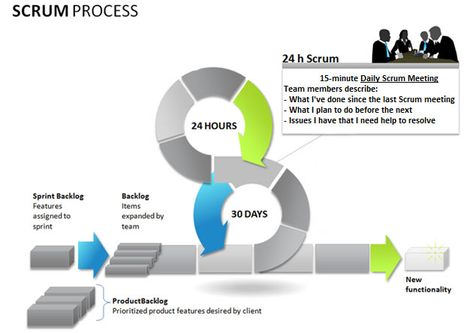

Slide 6
Scrum benefits
The product is broken down into a set of manageable and understandable chunks.
Unstable requirements do not hold up progress.
The whole team have visibility of everything and consequently team communication is improved.
Customers see on-time delivery of increments and gain feedback on how the product works.
Trust between customers and developers is established and a positive culture is created in which everyone expects the project to succeed.

Slide 7
Scaling agile methods
Agile methods have proved to be successful for small and medium sized projects that can be developed by a small co-located team.
It is sometimes argued that the success of these methods comes because of improved communications which is possible when everyone is working together.

Slide 8
Scaling out and scaling up
Scaling up agile methods involves changing these to cope with larger, longer projects where there are multiple development teams, perhaps working in different locations.
‘Scaling out’ is concerned with how agile methods can be introduced across a large organization with many years of software development experience.

Slide 9
Practical problems with agile methods
The informality of agile development is incompatible with the legal approach to contract definition that is commonly used in large companies.
Agile methods are designed for small co-located teams yet much software development now involves worldwide distributed teams.

Slide 10
Scaling up to large systems
A completely incremental approach to requirements engineering is impossible.
There cannot be a single product owner or customer representative.
For large systems development, it is not possible to focus only on the code of the system.
Cross-team communication mechanisms have to be designed and used.
Continuous integration is practically impossible. However, it is essential to maintain frequent system builds and regular releases of the system.

Slide 11
Distributed Scrum

Slide 12
Multi-team Scrum
Role replication
Each team has a Product Owner for their work component and ScrumMaster.
Product architects
Each team chooses a product architect and these architects collaborate to design and evolve the overall system architecture.
Release alignment
The dates of product releases from each team are aligned so that a demonstrable and complete system is produced.
Scrum of Scrums
There is a daily Scrum of Scrums where representatives from each team meet to discuss progress and plan work to be done.

